Slide 2
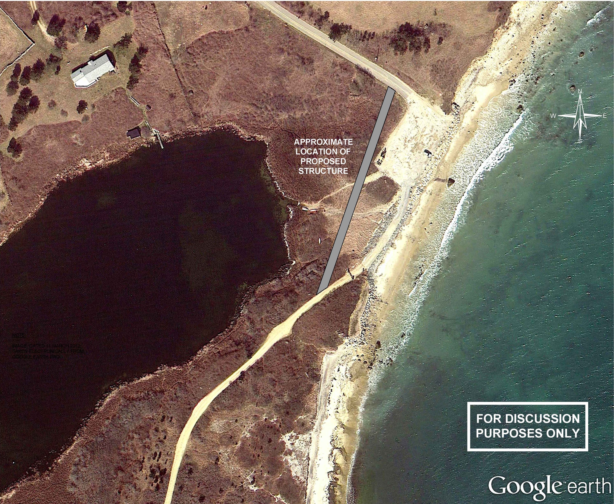
Elevated Roadway – Proposed Alignment
APPROXIMATELY 400 FT IN LENGTH

Slide 3
Elevated Roadway – Abutment Longevity
Western abutment is ~92 ft from existing shoreline
Local erosion rates are ~0.92 ft/year
This gives western abutment ~100 years
Glacial Till knob at Money Hill and boulders may decrease erosion pace

Slide 4
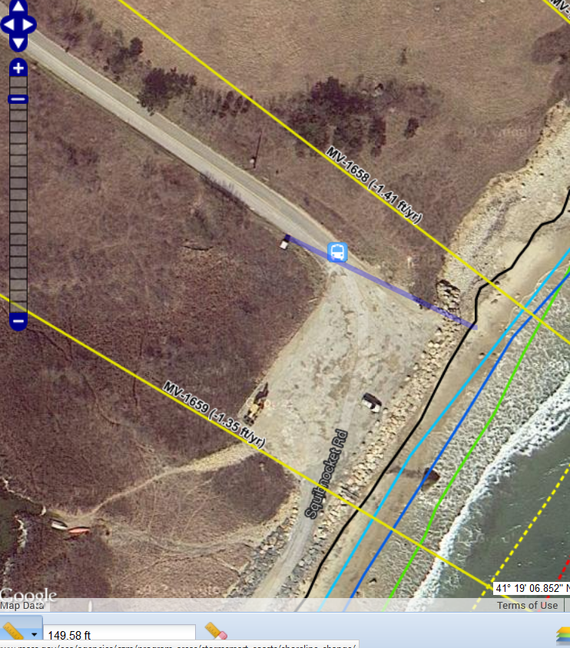
Elevated Roadway – Abutment Longevity
Eastern abutment is ~150 ft from existing shoreline and high water line
Local erosion rates are ~1.41 ft/yr
This gives eastern abutment >100 years
Remaining parking lot and revetment may decrease erosion pace

Slide 5
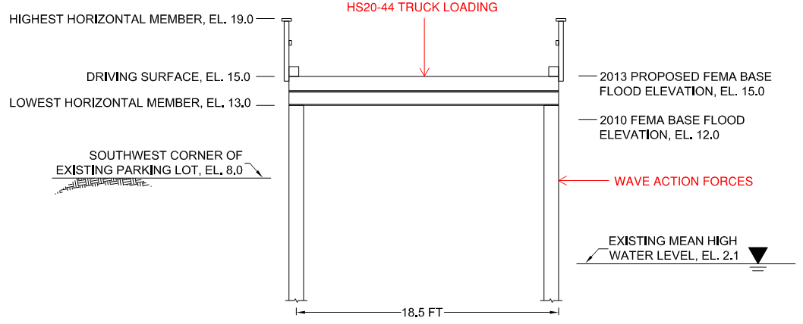
Elevated Roadway – Deck Longevity
2013 draft FEMA flood elevation for the proposed causeway area is El. 15.0.
Causeway deck is proposed at El. 15.0.
The causeway is designed to withstand wave forces up to El. 15 in case the deck is temporarily overtopped in a storm event.
TOP OF RAILING, EL. 19.0

